Slide 1


Specialized Course: Demand Forecasting
Time Series Practices

Slide 2
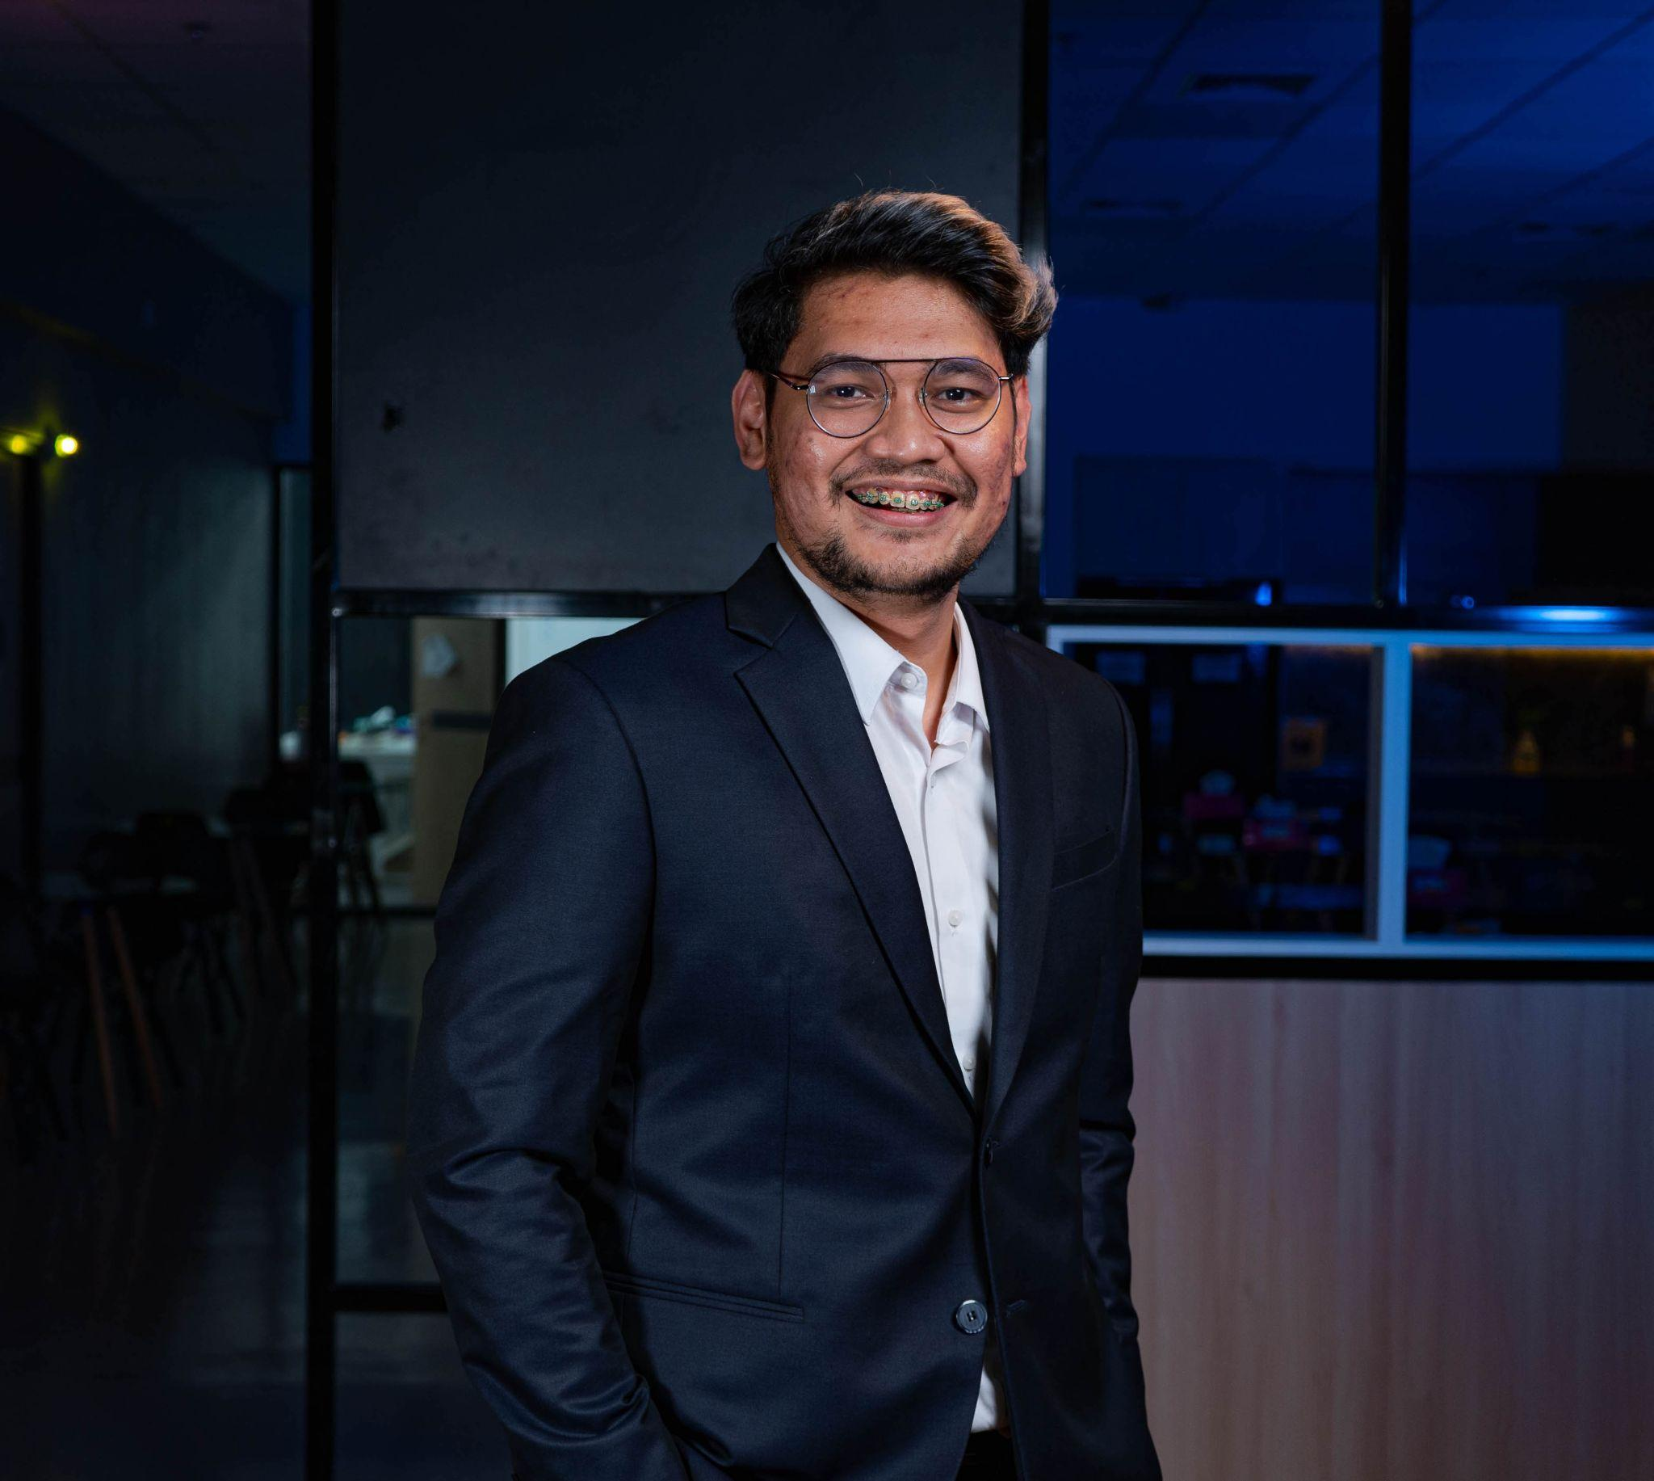


Trainer’s Profile
Perkenalkan, saya
Barry Cavin
Now Learning Specialist Coordinator - Kemdikbud (GovTech Edu)
2020 Head of Content - Zenius Education
2018 School Principal - Erudio Indonesia
2017 Data Scientist - Tokopedia
2016 MSc Applied Mathematics - Imperial College London
2015 Data Scientist - Dattabot
2010 SSi Matematika Murni - Universitas Indonesia
www.linkedin.com/in/barrysianturi
barrys.sianturi@gmail.com
TMT Training
2022

Slide 3

(Revised) Outline
01
Practicing dealing with time data
02
Resampling
03
Forecasting
04
Decomposition
TMT Training
2022

Slide 4
Time series data with timestamps and timeperiods
TMT Training
2022

Slide 5
Clone https://github.com/barrysianturi/TMT
TMT Training
2022

Slide 6

Next?
TMT Training
2022

Slide 7
Next
01
Demand Forecasting
02
Smoothing
03
Fine-tuning parameters
04
Panel Data
TMT Training
2022

Slide 8
THANK YOU!
TMT Training
2022

